Slide 1

WELCOME TO CFG
YOUR INTRODUCTION
TO WEB DEVELOPMENT
TECH SHOULDN'T JUST BE A BOYS CLUB.
Notes:
1] Welcome students back to class and while waiting for the room to settle down, ask them how the exercises and homework went last week.

Slide 2

COURSE JOURNEY
MODULE 4: JAVASCRIPT
HTML
CSS
Recap
Project design
Javascript
+ Overview & Data-types
Mock Project
GitHub
Optional Material
Project presentations
Careers in web development
MODULE 03
MODULE 04
MODULE 05
MODULE 02
MODULE 06
MODULE 01
Notes:
1] Take any questions they have about the session content

Slide 3
MODULE 1: HTML
Bootstrap overview
Mock project practice
How to publish a website with GitHub
MOCK PROJECT
05

Slide 4
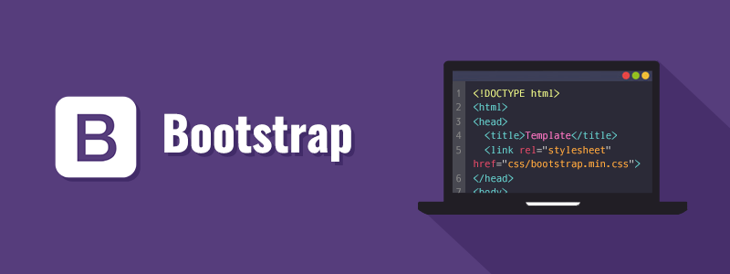
MODULE 5: GIT & FRAMEWORKS
Notes:
ACTIONS: explain what it is, during the ‘mock project’ you will show how to ‘wire’ bootstrap to our website.
There are many others and in the end it comes down to the developers choice
World’s most popular CSS Framework
Currently version 4
Easy to use (CDN)
Has a lot of components (navbars, carousels, jumbotrons, cards etc)
Can be quite bloated

Slide 5
MODULE 5: GIT & FRAMEWORKS
MOCK PROJECT
01 Let’s build a sample project
02 We publish the project live

Slide 6
THANK YOU
GOOD LUCK FOR YOUR PROJECT PRESENTATIONS!
TECH SHOULDN'T JUST BE A BOYS CLUB.

Slide 7

OPTIONAL TOPICS
THESE CONCEPTS ARE USEFUL TO KNOW – WE ENCOURAGE YOU TO SELF STUDY

Slide 8

WHAT IS GITHUB?
MODULE 5: GIT & FRAMEWORKS
As developers, we need ways to change our code without stepping on each other’s feet..
Git is software that tracks changes in your code. It “copies” the code on one branch to another so a developer can make changes
Github is a cloud platform where developers can store and share codebases (like Google Drive)
Github Pages is a free feature which hosts our static HTML, CSS and Javascript

Slide 9
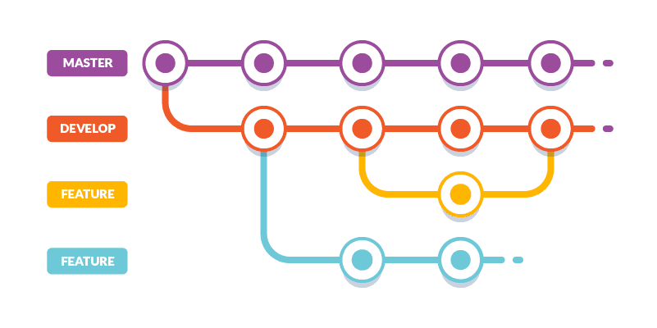
GIT WORKFLOW: OVERVIEW
MODULE 5: GIT & FRAMEWORKS
01 MASTER
Clean, working production-ready code
02 DEV
Clean, working, production-ready code also, meant as a buffer for potentially breaking features
03 FEATURE
Whether you’re adding, updating or deleting a feature (eg. an image gallery), it should be on its own branch
04 Github uses other keywords like PUSH, PULL, MERGE, ADD and COMMIT to move changes from one branch into another
Notes:
Github is scary for a lot of students when they first learn
Reassure them that this stuff can be tricky at first, but if they practice it enough they’ll understand the concept
We will only focus on master and dev branches today - after this slide, show them what a Master and Dev branch look like and do a mini demo. (They don’t actually need to use it, so you won’t need to go into too much detail)

Slide 10
USING GITHUB FOR
YOUR PROJECTS
MODULE 5: GIT & FRAMEWORKS
You can make and commit changes to your project directly through GitHub. If you wish to do so, please ensure you go through the Student guide and demos shared to understand how to collaborate using GitHub
For the purpose of this course, we will ensure our project is ready and use GitHub only to host our website.

Slide 11
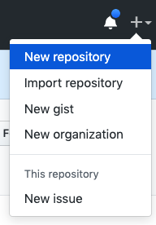

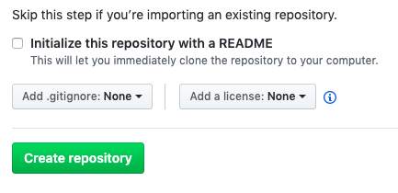
GITHUB PAGES
UPLOADING YOUR PROJECT
MODULE 5: GIT & FRAMEWORKS
Make sure you have Github Desktop installed and a Github account
Click the plus icon in the top left
Choose a name
Make sure ‘Initialise with a README’ is blank
username

Slide 12

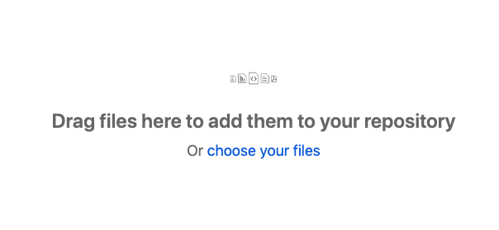
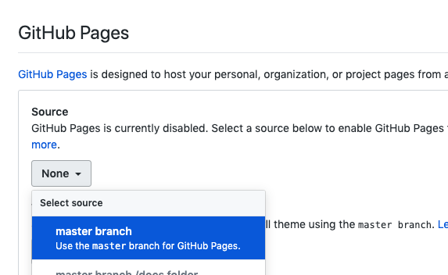
GITHUB PAGES
UPLOADING YOUR PROJECT
MODULE 5: GIT & FRAMEWORKS
On the next page, choose ‘Upload an existing file’
Navigate to your project and add all the files you want to upload
Once uploaded, add a message and commit changes
Refresh the page then go to settings and scroll down until you see Github Pages
For the branch, choose Master. When the page refreshes, scroll back down to the Github Pages section and you will see a URL
That’s it! (It may take a few minutes)
Notes:
May have to wait a few minutes and / or reload the browser to see the changes

Slide 13
UNDERSTANDING FRAMEWORKS
MODULE 5: GIT & FRAMEWORKS
What is a framework?
A skeleton of code providing generic functionality
You can use it as a base for your styles
You can also override the framework code with your own

Slide 14
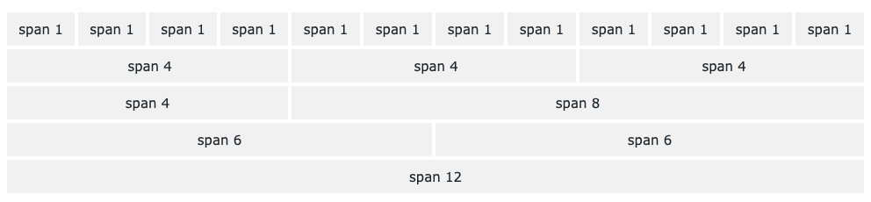
CSS FRAMEWORKS
MODULE 5: GIT & FRAMEWORKS
Designed to do the heavy lifting of writing responsive CSS
Nearly all use the grid system:
Containers made of rows made of 12 columns
12 columns because it’s easily divided into sixths, quarters, thirds and halves
Takes different screen sizes into account

Slide 15
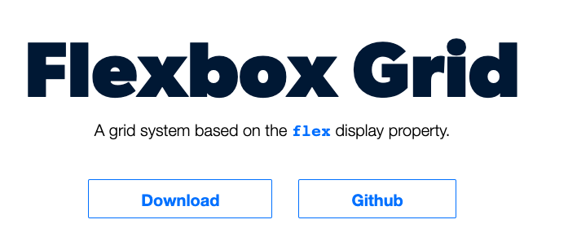

MODULE 5: GIT & FRAMEWORKS
#1: FLEXBOX GRID
Flexboxgrid
Lightweight, responsive, modern
Only uses containers, rows and columns
Requires download
Very basic
Notes:
There are many others and in the end it comes down to the developers choice

Slide 16
OPTIONAL PRACTICE
MODULE 5: GIT & FRAMEWORKS
Download from their github page - https://github.com/kristoferjoseph/flexboxgrid
Copy the flexboxgrid.min.css file into your own CSS folder
Link to it from your index.html (eg <link rel="stylesheet" href="./css/flexboxgrid.min.css">)
5 MINS
Notes:
Students can choose to follow along if they wish to. Focus is simply to show them how to access it and how to read the documentation

Slide 17



JAVASCRIPT FRAMEWORKS
MODULE 5: GIT & FRAMEWORKS
01 They use Javascript to create interactive HTML and CSS
02 Largely component-based (extremely reusable) and powerful. A vast majority of modern web apps use one
03 Typically require ~3 solid months of Javascript as a prerequisite
REACT
+ Facebook
+ Component-based
+ Has react-native for mobile apps
VUE
+ Independent, open-source
+ Component based
+ Popularity is skyrocketing
ANGULAR
+ Google
+ Mix of HTML and Typescript (very similar to Javascript)
+ Very powerful but huge framework

